Slide 1
Investigating Quantum Machine Learning Challenges
Through Binary Classification of Standard Image Datasets
Fouepe Dongmo Dylan Berkamp
Firenze, 30/06/2025

Slide 2
Introduction
Firenze, 30/06/2025
Introduction
Motivation & Goals
Motivation:
Exploring the practical challenges and opportunities in Quantum Machine Learning (QML) for binary image classification, inspired by the article of Cerezo & all. (2023)
Goals:
Evaluate classical, hybrid, and quantum kernel models.
Analyze performance, stability, and optimization issues
Compare results across datasets of increasing complexity

Slide 3
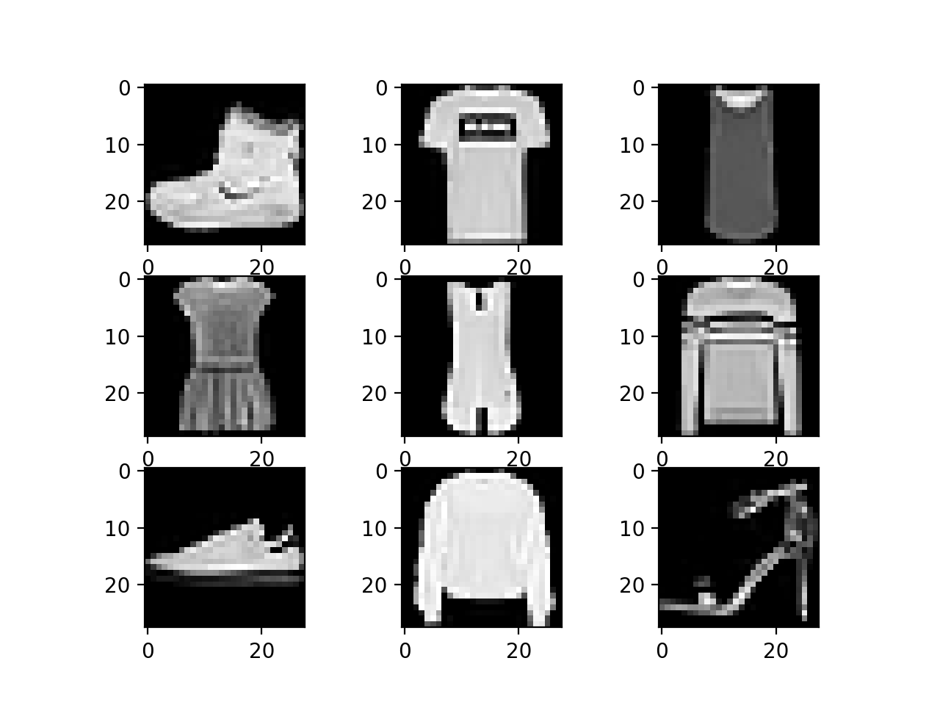
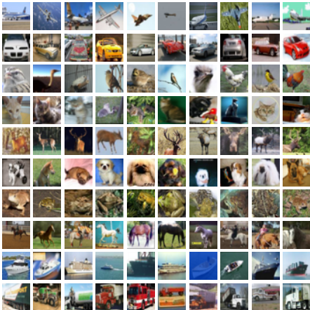
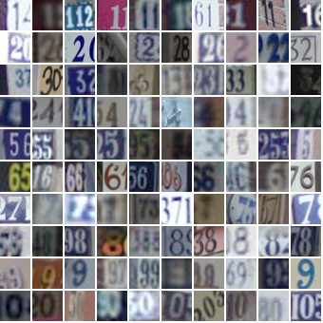
Datasets Overview
Firenze, 30/06/2025
Dataset:
Fashion-MNIST (Classes: Dress vs. Bag)
CIFAR-10 (Objects: Cat vs. Ship)
SVHN (Digits: 3 vs. 8)
Binary Task: Classes relabeled as 0/1

Slide 4
Models implemented
Firenze, 30/06/2025
Models implemented
Classical Models:
Residual MLP
Convolutional Neural Network (CNN)
SVM
Hybrid Quantum-Classical:
Quantum-Enchanced MLP
Hybrid QCNN
Kernel Mehods:
Quantum Kernel SVM.
Quantum Fidelity Kernel.

Slide 5
Training & Methodology
Firenze, 30/06/2025
Training & Methodology
Methodology:
Controlled datasets (3000 sampled for classical architecture & 500 for hybrid quantum architecture.
K-Fold Cross-Validation (3 folds).
Config-driven experiments (YAML files for reproducibility).
Metrics tracked: F1, Accuracy, Balanced Accuracy, precision, Recall, ROC-AUC
Quantum Circuits optimized with PennyLane’s lightning.qubit backend.

Slide 6
Firenze, 30/06/2025
Key Results – Classical Models
Classic MLP:
Fashion-MNIST: F1 ≈ 0.987, AUC ≈ 0.998 → ottima stabilità.
SVHN: F1 ≈ 0.80 → maggiore variabilità dovuta a rumore e complessità visiva.
CIFAR-10: F1 ≈ 0.79 → difficoltà senza bias spaziali.
Classic CNN:
Fashion-MNIST: F1 ≈ 0.99, performance stabile.
SVHN: F1 ≈ 0.92, miglioramento rispetto a MLP grazie al bias spaziale.
CIFAR-10: F1 ≈ 0.89, confermando l’importanza delle CNN su immagini complesse.
SVM:
Fashion-MNIST: F1 ≈ 0.99, performance stabile.
SVHN: F1 ≈ 0.92, miglioramento rispetto a MLP grazie al bias spaziale.
CIFAR-10: F1 ≈ 0.89, confermando l’importanza delle CNN su immagini complesse.

Slide 7
Key Results – Quantum Models
Firenze, 30/06/2025
Key Results – Quantum Models
Quantum MLP:
Fashion-MNIST: F1 media ≈ 0.64, alta varianza (un fold con F1=0 per instabilità).
SVHN: F1 ≈ 0.85, recall molto alto (~0.99) ma precision bassa.
CIFAR-10: F1 instabile, spesso <0.70, evidenziando le difficoltà di ottimizzazione.
Hybrid QCNN:
Fashion-MNIST: F1 ≈ 0.96, competitive.
SVHN: F1 ≈ 0.85–0.88, migliori di Quantum MLP ma ancora instabilità in alcuni fold.
CIFAR-10:F1 ≈ 0.74–0.78, confermando limiti nell’adattare circuiti quantistici a dataset complessi.

Slide 8
Key Results – Hybrid Kernel Methods
Firenze, 30/06/2025
Key Results – Hybrid Kernel Methods
Hybrid QCNN + SVM/QSVM: Implementati con kernel classici e quantum kernel (Quantum Fidelity).
Fashion-MNIST: accuratezza eccellente con SVM classico; Quantum kernel SVM achieves competitive accuracy and F1 comparable to classical CNNs on simpler, low-dimensional datasets.
SVHN
CIFAR-10: kernel quantistici mostrano potenzialità ma non superano le CNN standard, indicando necessità di miglioramenti in embedding e ottimizzazione.

Slide 9
Key Insights
Firenze, 30/06/2025
Key Insights
Classical MLPs: Excellent on Fashion-MNIST (F1~0.98).Struggle on SVHN and CIFAR-10 (F1~0.80).Lack of spatial bias limits performance on complex data.
Classical CNNs: Consistent improvements over MLPs across all datasets.Effective spatial feature extraction yields robustness on CIFAR-10.Quantum MLPsStrong performance on simple datasets when convergence occurs.High variance and fold failures on SVHN, CIFAR-10 due to barren plateaus.
Hybrid QCNNs: Combine CNNs’ spatial bias with quantum layers.Competitive recall vs classical models, but optimization instability on CIFAR-10.Hybrid CNN + Classical SVMStable, consistent performance on all datasets.CNN features with linear SVM classification effective even with small samples.
Hybrid QCNN + Quantum Kernel SVM: Fashion-MNIST: stable performance, clear quantum kernel separation.SVHN: performance drops, highlighting quantum kernels’ limits on noisy data.CIFAR-10: poor generalization, kernel heatmaps show overlapping class distributions.
General Observations: Classical models remain the most reliable on complex datasets. Quantum-enhanced models show promise for simple problems but require better optimization and circuit design for real-world applications.Incorporating spatial inductive biases (CNNs) improves both classical and hybrid quantum models, but scaling quantum methods to high-resolution images is a major challenge.

Slide 10
Future Directions
Firenze, 30/06/2025
Future Directions
Improve Quantum Circuit Design Test deeper or alternative quantum ansätze less susceptible to barren plateaus. Implement error mitigation techniques to stabilize training.
Advanced Hybrid Architectures Combine more powerful CNN backbones before quantum layers.
Investigate quantum attention mechanisms and quantum transformers.
Efficient Quantum Kernels Explore randomized or approximate quantum kernels for scalability.
Develop training-friendly kernel methods for large datasets.
Hyperparameter Optimization Automate tuning of classical + quantum parameters (e.g., Optuna).
Jointly optimize classical and quantum components.
Scaling to Complex Datasets Adapt models to higher-complexity datasets (CIFAR-100, TinyImageNet).
Use synthetic data to analyze failure modes (class overlap, data noise).
Hardware Validation Run experiments on real quantum devices (IBM Q, IonQ). Address noise, decoherence, and gate depth limitations.
Visualization & Interpretability Develop tools for understanding quantum kernel behavior and feature separability. Create quantum influence maps to interpret decision boundaries.

Slide 11
Conclusions
Firenze, 30/06/2025
Conclusions
Classical Models: Strong, reliable performance, especially CNNs on complex datasets.
Quantum Models: Show potential but limited by instability and scalability issues.
Hybrid Models: Offer a middle ground; more stable than pure quantum but still behind classical CNNs.
Key Insight: Classical models excel today; quantum methods need advances in optimization, architecture, and noise resilience to compete.

Slide 12
References
Firenze, 30/06/2025
References
Ceroze et al., 2023 «Challenges and Opportunities in Quantum Machine Learning.»
Abhijith J. et al., 2022 Quantum Algorithm Implementations for Beginners.
Maria Schuld et al Machine Learning with Quantum Computers second edition.
Corse Materials

Slide 13
Acknowledgements
Firenze, 30/06/2025
Acknowledgements
Thanks to Prof. Caruso and Dr. Martina for guidance and course materials.
Tools used: PyTorch, PennyLane, scikit-learn, wandb, ChatGpt.

Slide 14

Questions ?
Firenze, 30/06/2025
Questions ?
The future of quantum-enhanced AI starts here
let’s keep exploring!

